Slide 1
Data Link layer Protocol and Devices.

Slide 2
Address Resolution Protocol :
•
Address Resolution Protocol is one of the most important protocols of the network layer in the OSI model which helps in finding the MAC(Media Access Control) address by using IP address.

Slide 3
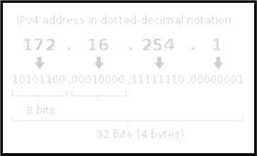
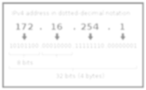
Logical Address / IP Address :
A logical address is a 32 bits address sequence of 1’s and 0’s.
The hosts and routers are recognized at the network level by their logical addresses.
A logical address is an internet address.

Slide 4
Physical Address / Mac Address:
In order to communicate or transfer the data from one
computer to another computer we need some address. Media
Access Control Address is a physical address which works at Data Link Layer.
MAC Addresses are unique hardware number of a computer, which
is embedded into network card (known as Network Interface Card)
during the time of manufacturing. MAC Address is also known as Physical Address of a network device.
MAC addresses are unique 6 Byte or 48 bit hardware number.
Example: 00-0b-75-b1-c0-8e
: : | : | : | :
. | . | . | . | .

Slide 5
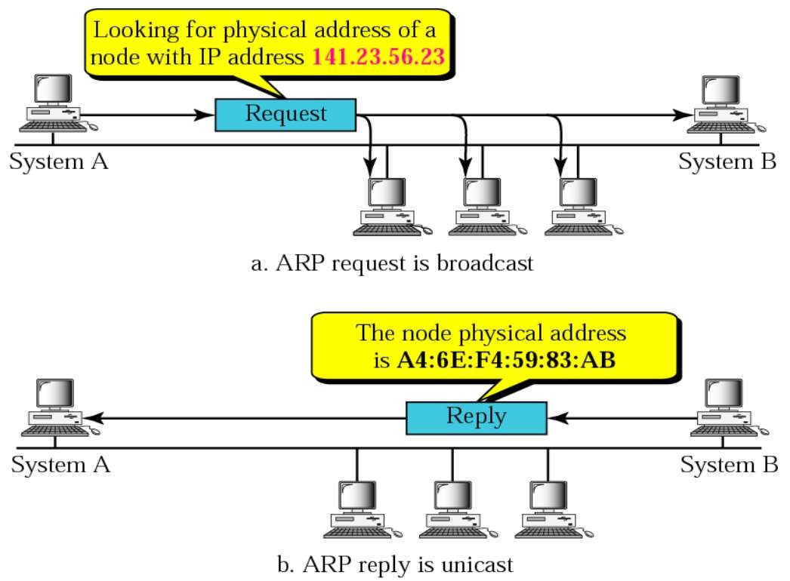
Work Procedure:

Slide 6

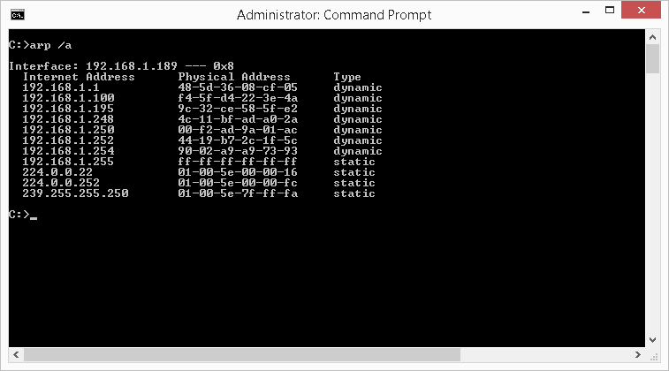
Terminologies of ARP:
1. ARP Cache: After resolving MAC address, the ARP sends it to the source where it stores in a table for future reference

Slide 7

2. ARP request: This is nothing but broadcasting a packet over the network to validate whether we came across destination MAC address or not.

Slide 8

3. ARP response/reply: It is the MAC address response that the source receives from the destination which aids in further communication of the data.

Slide 9
Disadvantages of ARP:
1.There may be ARP attacks like ARP spoofing or ARP Denial of Services. ARP Spoofing is a technique that allows an attacker to attack an Ethernet Network which may lead to sniffing of data frames on switched Local Area Network or to the attacker may stop the traffic altogether which is also known as ARP denial of Services.

Slide 10
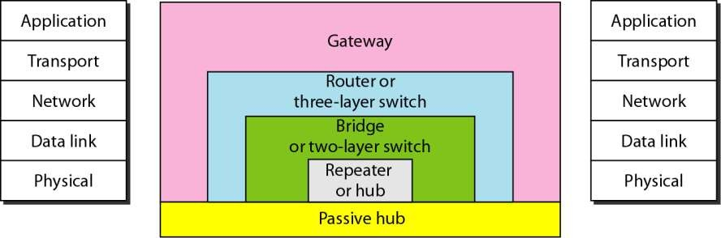
CONNECTING DEVICES
We divide connecting devices into five different categories based on the layer in which they operate in a network.
FIGURE : FIVE CATEGORIES OF CONNECTING DEVICES

Slide 11
We have the topics to discuss are as follows:
Passive hubs.
Repeaters.
Active hubs.
Bridges.
Two – Layer Switches.
Routers.
Three-Layer Switches.
Gateway.

Slide 12
1.PASSIVE HUBS
A passive hub is just a connector. It connects the wires coming from different branches. In a star-topology Ethernet LAN, a passive hub is just a point where the signals coming from different stations collide; the hub is the collision point. This type of a hub is part of the media; its location is the Internet model is below the physical layer.

Slide 13
2.REPEATERS
A repeater is a device that operates only in the physical layer.
A repeater connects two segments of a LAN.
A repeater forwards every frame.
A repeater is a regenerator , not an amplifier.

Slide 14
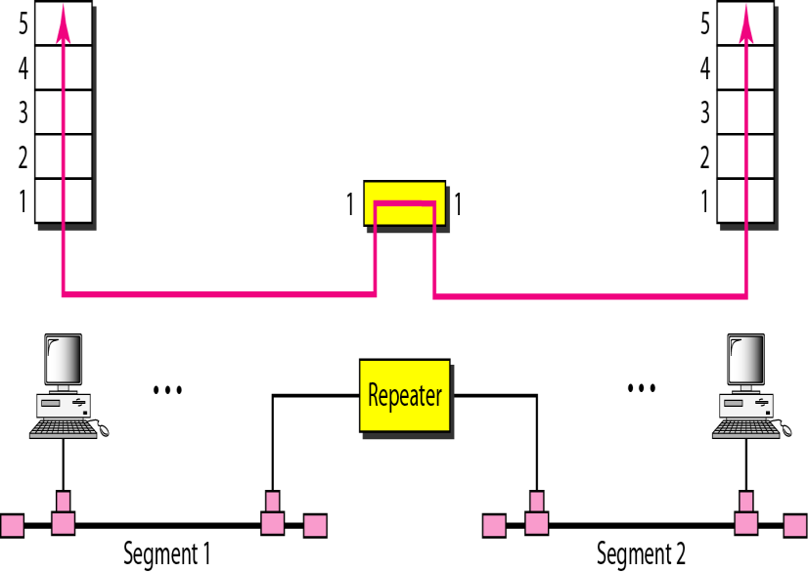
FIGURE : A REPEATER CONNECTING TWO SEGMENTS OF A LAN

Slide 15
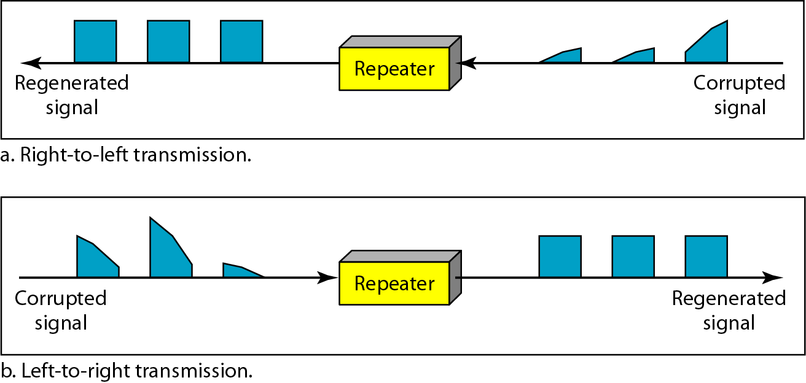
FUNCTION OF A REPEATER

Slide 16
3.ACTIVE HUBS
An active hub is actually a multiport repeater. It is normally used to create connections between stations in a physical star topology.

Slide 17
4.BRIDGES
A bridge operates in both the physical and the data link layer. As a physical layer device, it regenerates the signal as it receives. As a data link layer device, the bridge can check the physical (MAC) addresses (source and destination) contained in the frame.

Slide 18
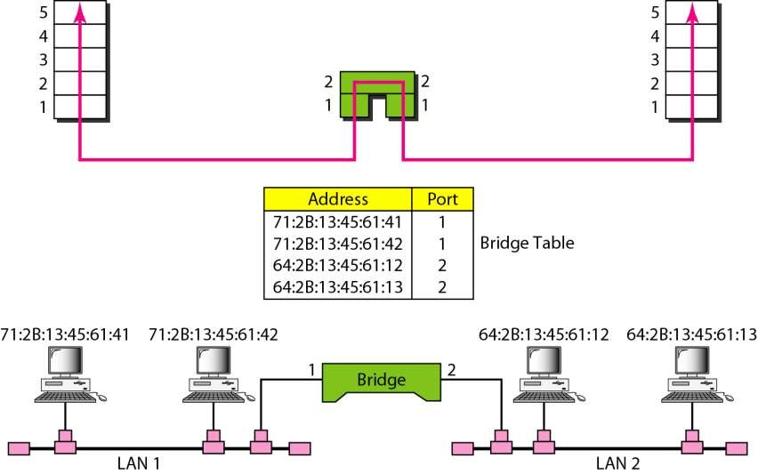
FIGURE : A BRIDGE CONNECTING TWO LANs

Slide 19
5.TWO-LAYER SWITCHES
In this , we can have a two-layer switch or a three-layer switch. A three-layer switch is used at the network layer; it is a kind of router. The two-layer switch performs at the physical and data link layers.
A two-layer switch is a bridge, a bridge with many ports and a design that allows better (faster) performance.
A two-layer switch, as a bridge does, makes a filtering decision based on the MAC address of the frame it received.

Slide 20
6.ROUTERS
A router is a three-layer device that routes packets based on their logical addresses (host-to-host addressing). A router normally connects LANs and WANs in the Internet and has a routing table that is used for making decisions about the route. The routing tables are normally dynamic and are updated using routing protocols.

Slide 21
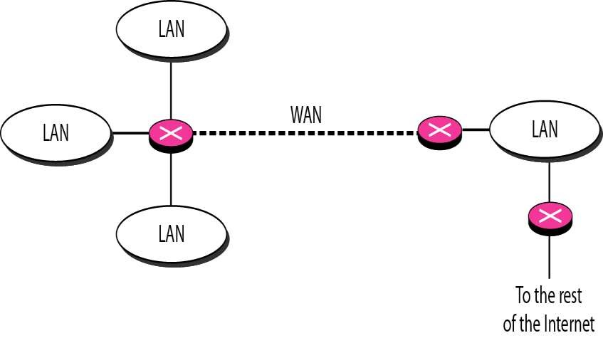
FIGURE : ROUTER CONNECTING INDEPENDENT LANs AND WANs

Slide 22
7.THREE-LAYER SWITCHES
A three-layer switch is a router , but a faster and more sophisticated. The switching fabric in a three-layer switch allows faster table lookup and forwarding.

Slide 23
8.GATEWAY
A gateway is normally a computer that operates in all five layers of the Internet or seven layers of OSI model. A gateway takes an application message ,reads it, and interprets it. This means that it can be used as a connecting device between two internetworks that use different models.

